Slide 1
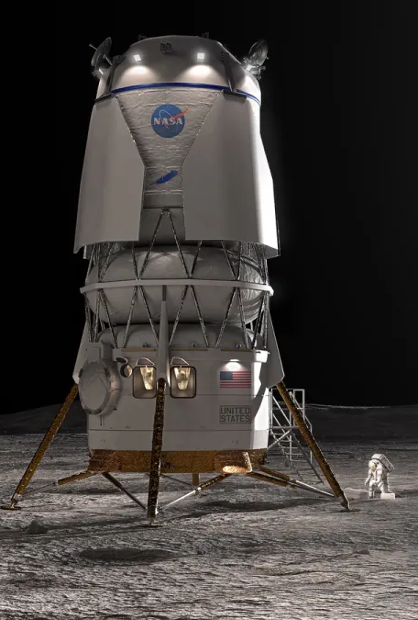

Lunar Lander using OpenAI V3 – Continuous Action Space
Name: Vedant Malhotra ,Dhyanesh Sharma ,Vidyansh Gaur
Roll no.: 23csu339 ,23csu100,23csu342

Slide 2
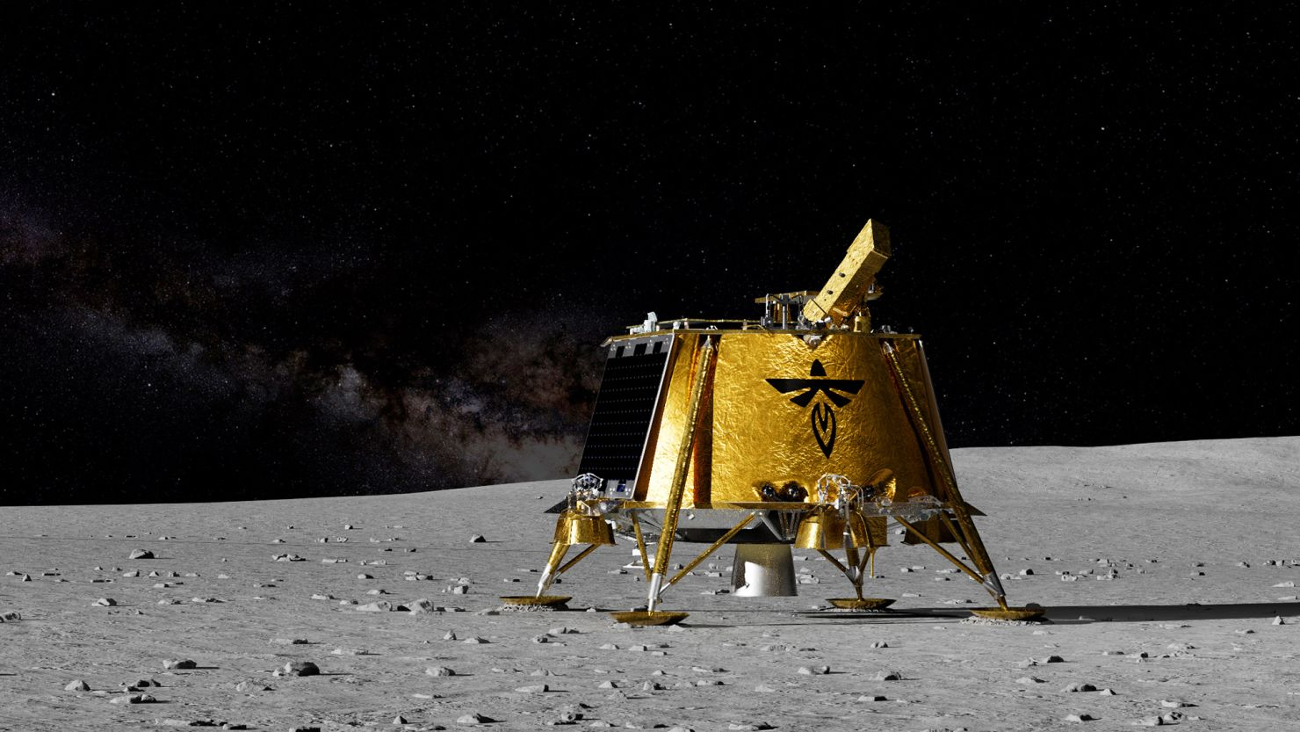
Project Objective
The project aims to train an autonomous agent to safely land a spacecraft on a designated pad using continuous control inputs between –1 and +1. The agent learns to balance thrust, direction, and stability. To solve this continuous control challenge, the project uses the Deep Deterministic Policy Gradient (DDPG) algorithm with Actor–Critic neural networks to learn optimal landing strategies through interaction and feedback.

Slide 3
Deep Deterministic Policy Gradient
(DDPG) algorithm
DDPG is a reinforcement learning algorithm used for continuous control problems.
It learns how to choose smooth, continuous actions (like throttling, steering, or controlling thrust) using two neural networks:
One network decides the action (Actor) and another evaluates how good that action is (Critic).
Together, they help the agent learn stable and precise control in environments like Lunar Lander, robots, and motors.
Notes:
DDPG uses two networks:
Actor Network
Outputs the best continuous action$a=π\left(s\right)$
Critic Network
Estimates Q-value of that action$Q\left(s , a\right)$
Actor–Critic in simple terms
Actor
The actor is a neural network that decides what action to take in a given state.
It directly outputs actions like thrust or steering angle.
In simple words:
Actor = the decision-maker.
Critic
The critic is a neural network that evaluates how good the actor’s action is.
It learns a Q-value (expected future reward) of taking action a in state s.
In simple words:
Critic = the evaluator or judge.
The actor tries to improve based on feedback from the critic.
What is a Value Function in RL?
A value function tells how good it is to be in a state or take an action.
Examples:
• V(s): value of being in state s
• Q(s, a): value of taking action a in state s
Value = expected future reward.
What is a Policy in RL?
A policy tells the agent what action to take.
There are two types:
Deterministic Policy (Simple Meaning)
A deterministic policy always gives one fixed action for a given state.
If the state is the same, the action will always be exactly the same.
Example:
State = "lander is tilted left"
Deterministic policy action = "apply right thruster (exact value 0.42)"
There is no randomness.
Stochastic Policy (Simple Meaning)
A stochastic policy gives a probability distribution of actions for a given state.
The action you take can vary because it is sampled from probabilities.
Example:
State = "lander is tilted left"
Stochastic policy might say:
• 70% chance → apply right thruster
• 30% chance → apply main engine
Policy = the agent’s behavior rule.
So we add Gaussian noise:
$$a=π\left(s\right)+𝒩\left(0 , σ\right)$$
DDPG uses a deterministic policy.
This means, for the same state, the actor gives the exact same action every time.
But reinforcement learning needs exploration, otherwise:
The agent will keep repeating the same actions
It might get stuck in suboptimal behaviour
It will not discover better solutions
Since the actor does not explore by itself, we manually add noise to its output during training.
Example:
action = actor(state) + noise
DDPG uses two sets of networks:
Main Actor & Critic → these learn fast
Target Actor & Critic → these move slowly
WHY?
If the Actor and Critic update too quickly, the learning becomes unstable (like running on shifting ground).
So DDPG uses soft updates:
$$θ_{\text{target}}←τθ+\left(1−τ\right)θ_{\text{target}}$$

Slide 4
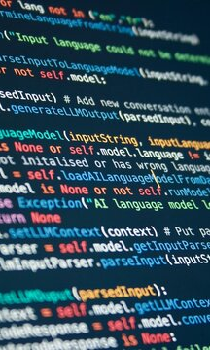
Code Implementation
Libraries Used
Core DDPG Algorithm Module
Model Training, Logging & Saving Module
• Model Files (.pth) – Saved Actor & Critic Weights
• Training Log Files – Rewards & Step-wise Parameters
The Final Flight Demonstration Module
Graphical Visualization of Rewards & Parameters Module

Slide 5
1.Libraries Used
S No. | Library Type | Library Name
1. | Core Python & Utilities | Os , json, datetime, random
2. | Deep Learning (PyTorch) | Torch,torch.nn as nn ,torch.optim as optim , torch.nn.functional as F
3. | Reinforcement Learning Environment (Gymnasium ) | Import gymnasium as gym
4. | Simulation Rendering | Pygame (import pygame)
Notes:
torch
Main PyTorch library used for tensors, math operations, and gradients.
torch.nn
Used to build neural networks (layers, activations, loss functions).
torch.optim
Provides optimizers like Adam for updating network weights.
torch.nn.functional (F)
Contains activation functions and utility functions used inside networks.

Slide 6
2.Core DDPG Algorithm Module
This file constitutes the core implementation of the DDPG algorithm. Its primary purpose is to define and manage the fundamental components required for continuous control reinforcement learning.
This Module contains four core components, each responsible for a specific part of the DDPG algorithm and learning process.
1.Actor Class – Neural Network for Action Selection
2.Critic Class – Neural Network for Q-Value Estimation
3.ReplayBuffer Class – Experience Storage & Sampling System
4.DDPGAgent Class – Core Learning, Updating & Control Logic
Notes:
1. Actor Class – Neural Network for Action Selection
The Actor is a neural network that decides what action the agent should take in each state.
It represents the policy of the agent.
Input → state
Output → continuous action (like engine thrust values in Lunar Lander)
The actor learns to produce actions that lead to higher rewards.
In DDPG, this action is deterministic (no randomness).
To enable exploration during training, small noise is later added externally.
2. Critic Class – Neural Network for Q-Value Estimation
The Critic is another neural network.
Instead of choosing actions, it evaluates actions by estimating:
Q(s, a) = how good this action is in this state
The critic uses the Bellman equation to learn the expected future reward.
Its job is to guide the actor by telling it which actions are “better.”
So:
Actor → suggests actions
Critic → scores those actions
This cooperation is what makes DDPG a stable algorithm.
3. ReplayBuffer Class – Experience Storage & Sampling System
The replay buffer stores past experiences of the agent:
(state, action, reward, next_state, done)
This storage helps the learning process in two important ways:
It breaks the correlation between consecutive frames.
(Training on shuffled experiences stabilizes learning.)
It allows the agent to reuse past experiences many times.
(This makes learning sample-efficient.)
During training, mini-batches are randomly sampled from this buffer and fed into the actor and critic for learning.
4. DDPGAgent Class – Core Learning, Updating & Control Logic
This is the central class that manages the entire DDPG process.
It brings together:
• Actor
• Critic
• Target Actor
• Target Critic
• Replay Buffer
DDPG uses a deterministic policy.
This means, for the same state, the actor gives the exact same action every time.
But reinforcement learning needs exploration, otherwise:
The agent will keep repeating the same actions
It might get stuck in suboptimal behaviour
It will not discover better solutions

Slide 7

3.Model Training, Logging & Saving Module
​
This script manages the entire training workflow. It sets up the environment, loops through episodes, collects experience, triggers model updates, logs rewards, and saves training data.
This file is responsible for teaching the agent using the DDPG algorithm and generating the final trained models.
​

Slide 8
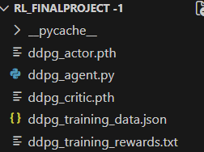
Model Files (.pth) – Saved Actor & Critic Weights
ddpg_actor.pth – The Learned Decision-Making Mind
This file stores the fully trained Actor neural network, it is responsible for choosing continuous actions (thrust values) based on the lander’s current state. It represents the agent’s final policy — the actual “brain” that decides how to land after thousands of training steps.
ddpg_critic.pth – The Value Estimation Engine
This file contains the trained Critic network, which evaluates how good a particular state–action pair is. Think of this as the internal judge that helped shape the lander’s decision-making ability.

Slide 9
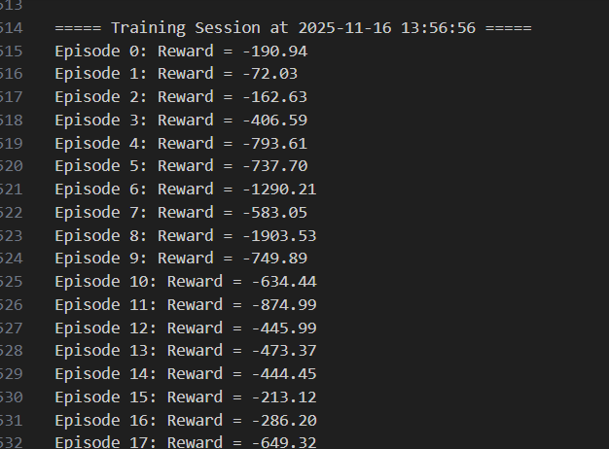
Training Log Files – Rewards & Step-wise Parameters
Training Log Files ddpg_training_rewards.txt
A simple but essential log that stores the total reward earned in every episode. It allows you to plot the Reward vs Episodes graph.
ddpg_training_data.json
This JSON file records step-by-step details of each episode: position, velocity, angle, thrust commands, and other key variables. It is used for deep analysis to understand how the agent behaved, why it succeeded or failed, and how its actions evolved over time.

Slide 10
4.The Final Flight Demonstration Module
This file loads the trained models and runs the LunarLanderContinuous-v3 environment in human-render mode. It shows the final behavior of the agent, tracks total reward, and displays landing success. This script acts as the performance demo, visually proving that the lander can descend and touch down safely.

Slide 11
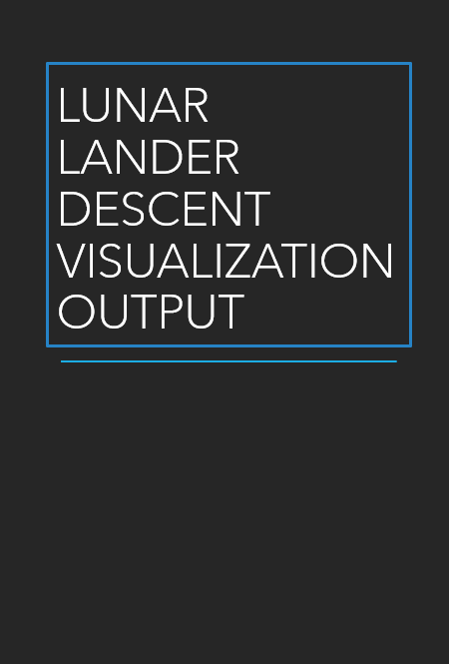
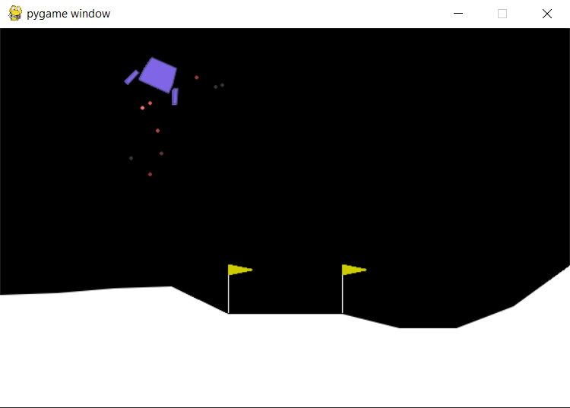
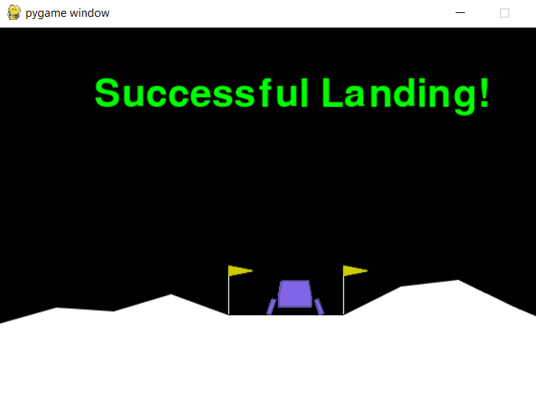
Lunar Lander Descent Visualization Output

Slide 12
5.Graphical Visualization of Rewards & Parameters Module
This section of the project analyses all training logs and visualizes how learning progressed. It plots reward curves, action patterns, lander trajectories, and behavior metrics. This file helps interpret the agent's learning process and gives a deeper understanding of how the policy improved over time.

Slide 13
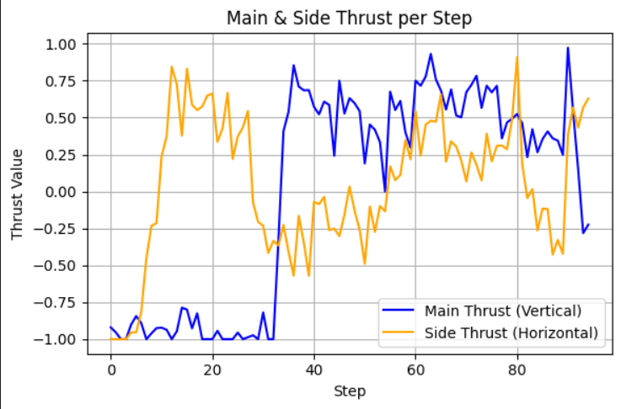
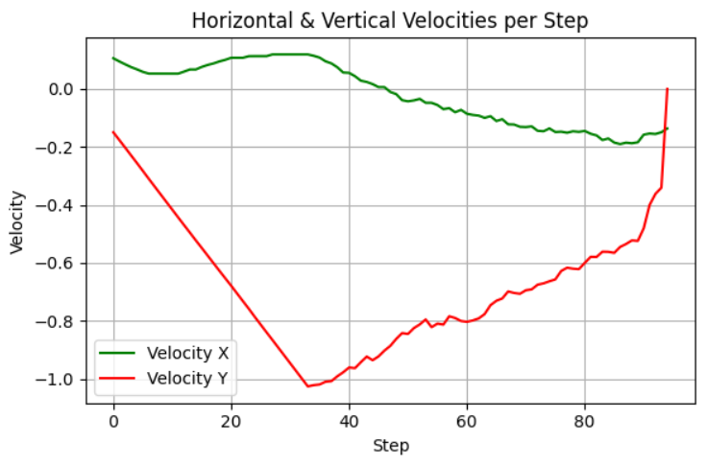
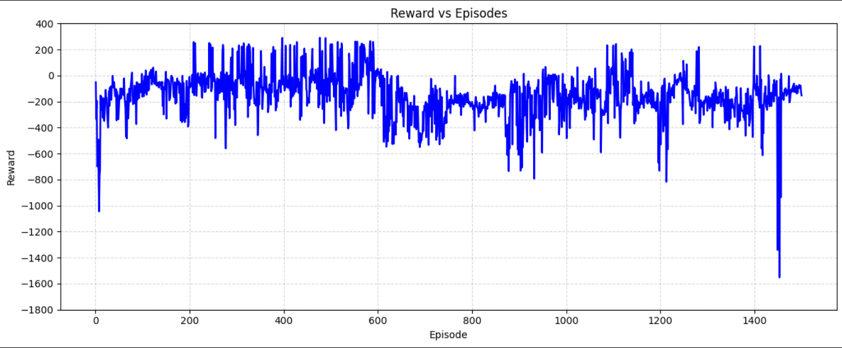
Thrust, Velocity & Reward Parameter Analysis

Slide 14
CHALLENGES & FUTURE IMPROVEMENTS
Training Challenges -
Continuous-action training is unstable and rewards fluctuate widely.
The agent struggled early with high speed, unstable angles, and hard landings.
DDPG is very sensitive to hyperparameters — small changes can break learning.
Exploration in continuous action space is weak, causing slow early learning.
.
Future Improvements -
Replace DDPG with TD3 for more stable learning.
Tune exploration noise decay for smoother exploration over time.
Add better reward shaping for angle, velocity, and smooth descent.

Slide 15

Thank you

